Slide 1
Coil Springs and Strut Assemblies
NATEF Task Area A4 Suspension

Slide 2

Coil Springs and Strut Assemblies
This power point and the corresponding worksheet will help prepare you to remove and install a coil spring and strut on a vehicle and know why you are doing it.

Slide 3
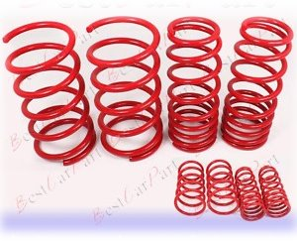
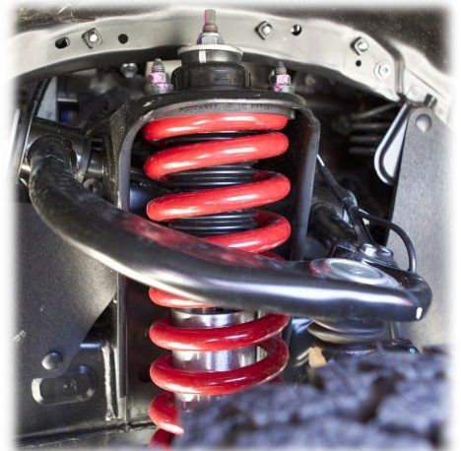

Coil Springs

Slide 4
Coil Springs
Caution!
A coil spring can be one of the most dangerous components of a vehicle if handled incorrectly. Caution must be exercised when working with struts and springs and procedures must be followed to ensure safety.

Slide 5
Coil Springs
Coil springs are the most common type of springs used on cars today. A coil spring is a spring-steel rod wound into a spiral. All springs must jounce and rebound (compress-extend) as the vehicle travels over uneven road surfaces. The springs support the weight of the vehicle while allowing the suspension system parts to move up and down.

Slide 6
Coil Spring
Problems
The two most common reasons for replacement of coil springs are suspension sag or breakage. When a coil spring sags or breaks, the vehicle height is reduced; which changes the alignment of the wheels, causes premature tire wear, and degrades the vehicle’s ride.
Coil springs must always be replaced in pairs!

Slide 7
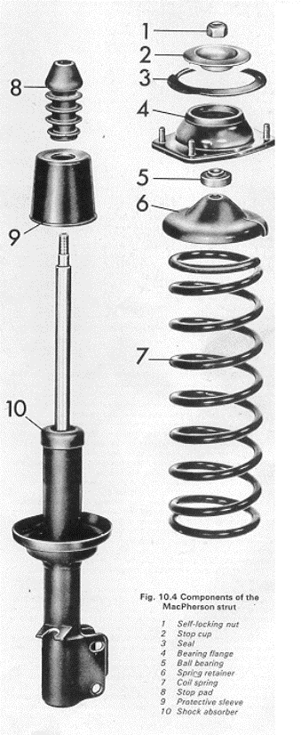
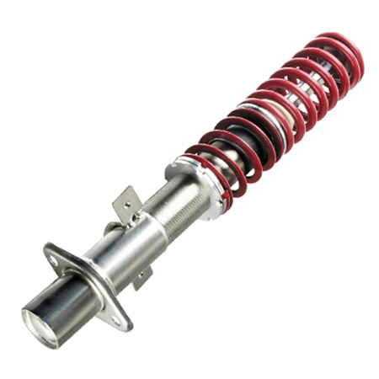
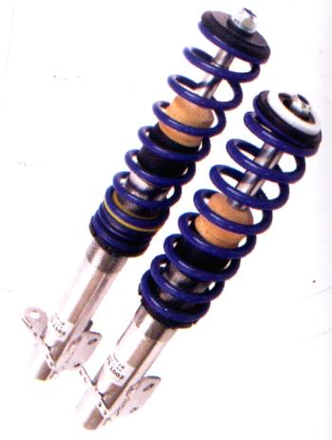
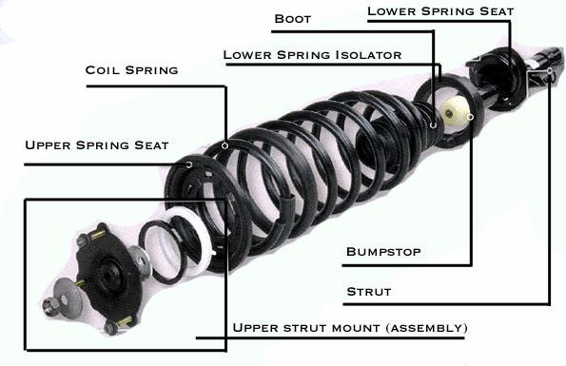
McPherson Struts

Slide 8
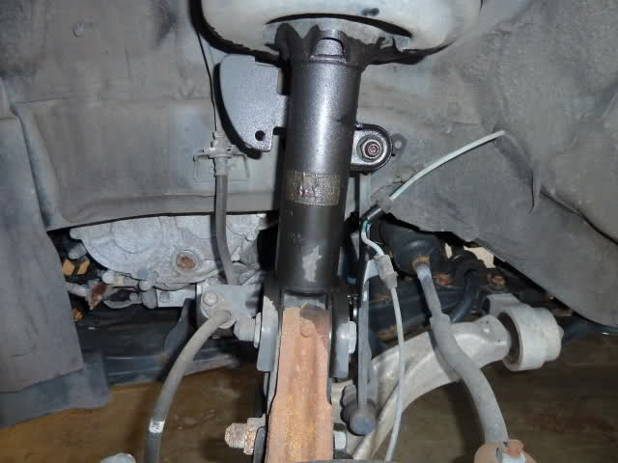
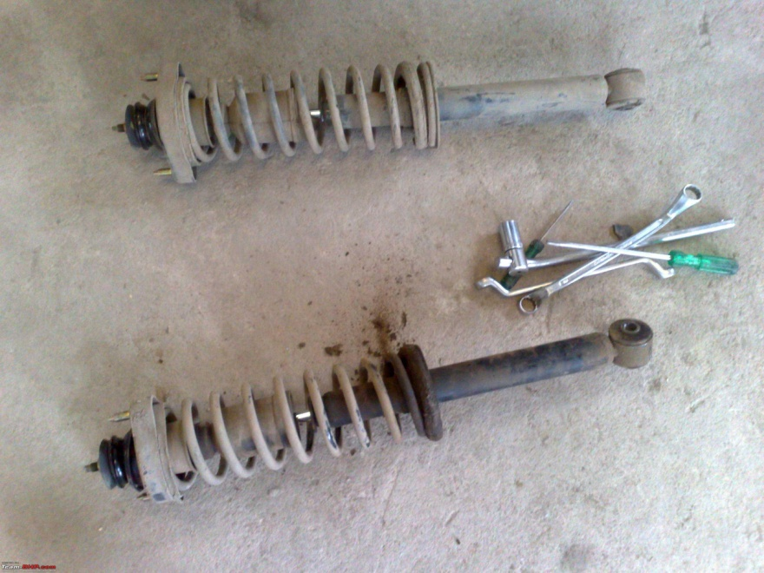
McPherson Struts
Problems
The most common reasons to replace struts include: leaking fluid, bent, dented housing, and poor vehicle ride (vehicle will continue to bounce up and down after hitting a bump or dip in the road surface). Struts must always be replaced in pairs to ensure an even and smooth ride.

Slide 9

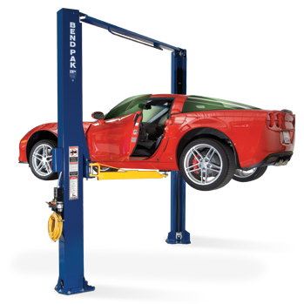
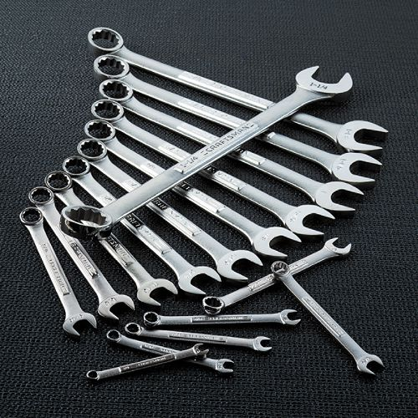
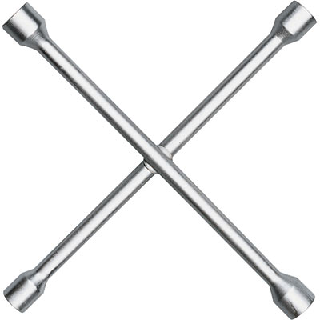
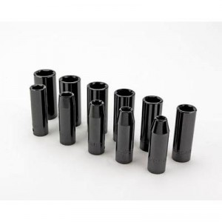
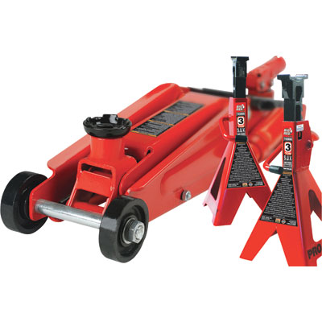
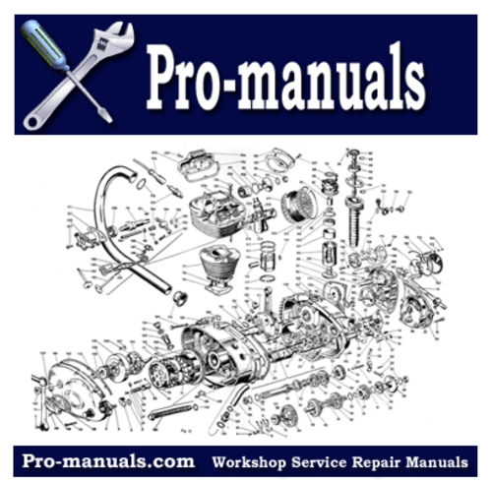
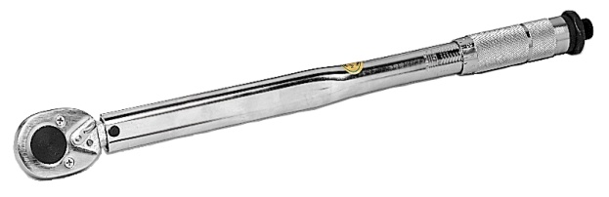
Coil Spring & Strut
Replacement
Tools Needed:
EYE Protection
Hand Tools
Lug Wrench, Torque Wrench, and Sockets
Jack and Safety Stands, or Hoist
Vehicle Service Information System or Repair Manual

Slide 10
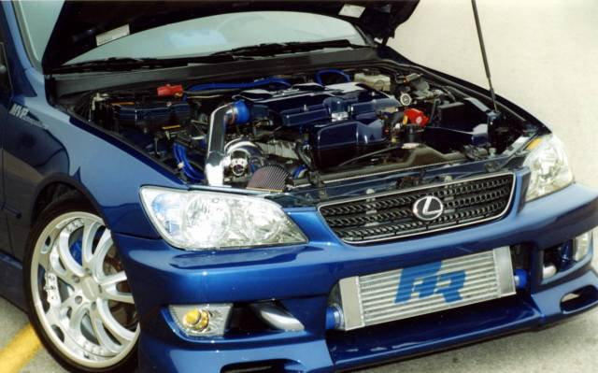
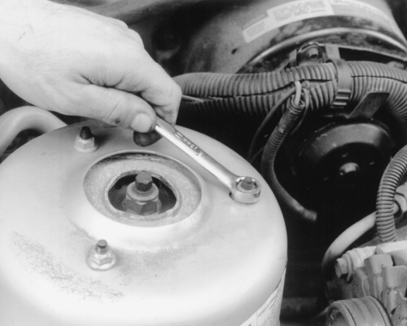
Coil Spring & Strut
Replacement
Procedure:
Wear EYE Protection!
Raise and secure vehicle on hoist
Open hood and remove top strut retaining nuts.

Slide 11
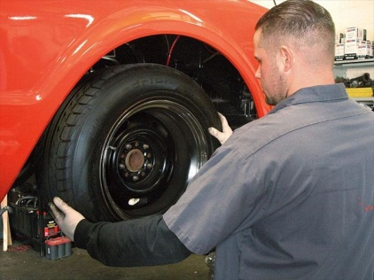
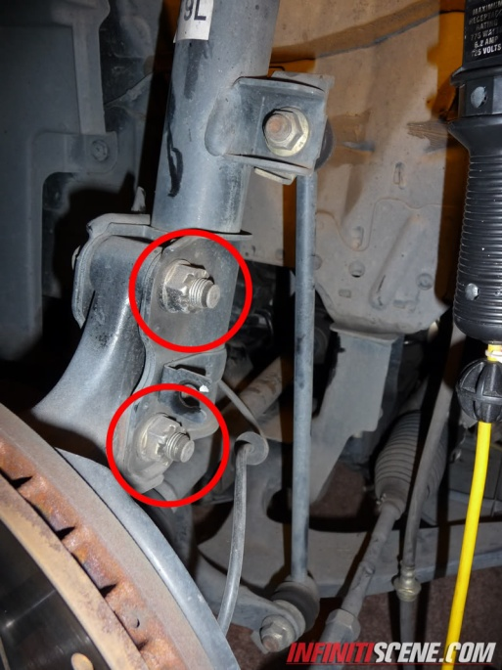
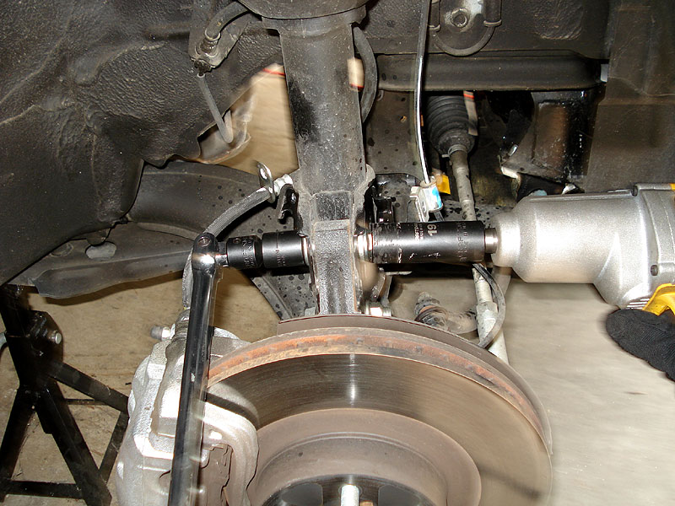
Coil Spring & Strut
Replacement
Procedure continued:
Remove front tire
Separate brackets or brake lines from strut
Remove both lower strut retaining bolts and nuts

Slide 12
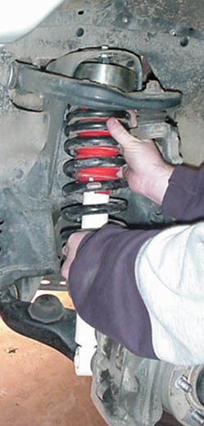
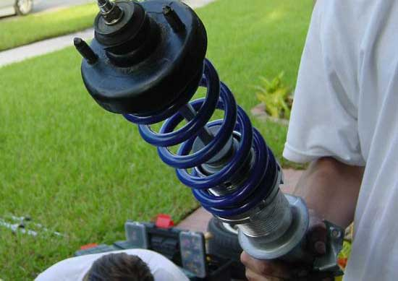
Coil Spring & Strut
Replacement
Procedure continued:
Remove strut

Slide 13
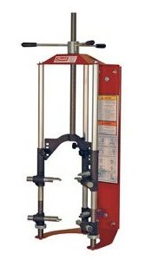
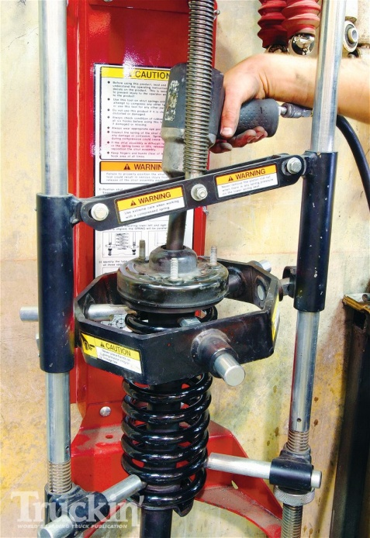
Coil Spring & Strut
Replacement
Procedure continued:
Place strut in coil spring compressor unit
Compress spring just enough to remove tension on top strut mount
Use impact to remove top retaining nut
Remove parts carefully and lay out in order of removal
This will facilitate re-installation

Slide 14
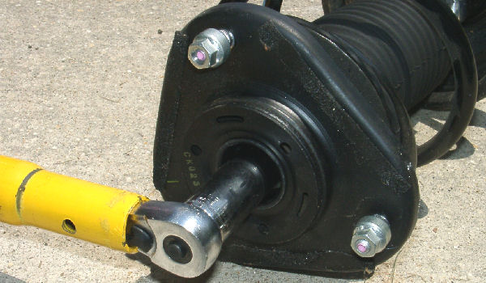
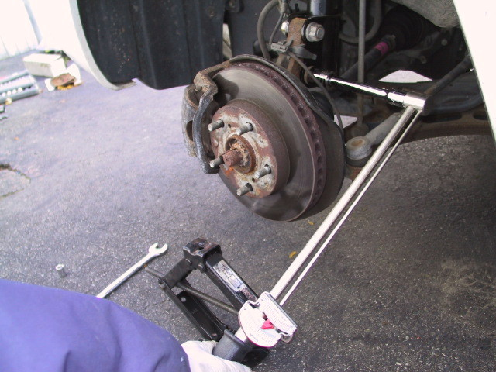
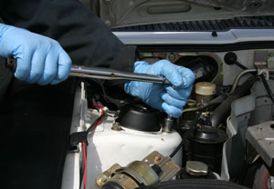
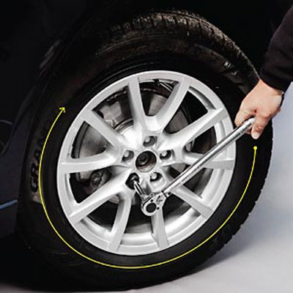
Coil Spring & Strut
Replacement
Procedure continued:
Reassemble strut in reverse order of disassembly
(With new parts replaced as needed)
Re-install strut in reverse order of removal
Torque all fasteners to specs

Slide 15
Coil Spring & Strut
Replacement
When you finish the accompanying worksheet, please take the on-line quiz to check your understanding of the information covered in this power point and worksheet. When you pass the quiz with a 100% you should be ready to print out the task sheet and go out to the shop and perform this task.☺

Slide 16
Questions?
Review this power point again
Review your completed worksheet
Ask three other students that have successfully finished the worksheet and quiz
Ask your instructor
By
Instructor Vance Bloom
ASE Certified Master Automotive Technician

